Slide 1



Slide 2
Leading with Strength
Applying Marine Core Leadership Traits to Software Development Teams

Slide 3
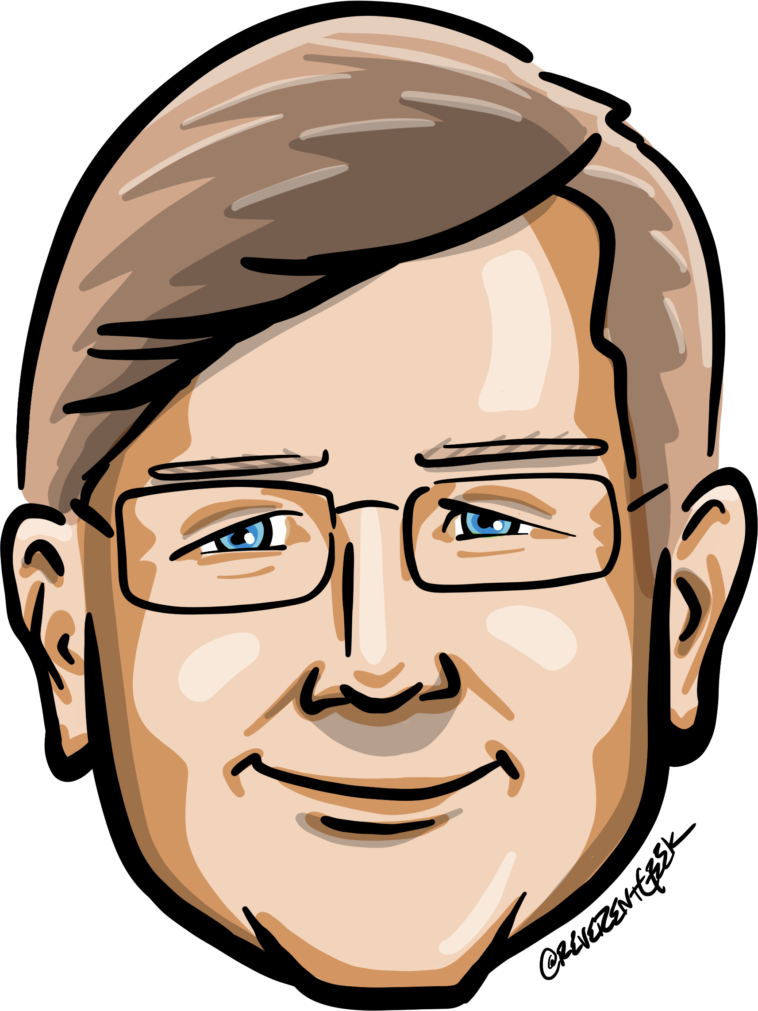






Who is Chad Green
Who is Chad Green
chadgreen@chadgreen.com
TaleLearnCode
ChadGreen.com
ChadGreen & TaleLearnCode
ChadwickEGreen

Slide 4

Who is Chad Green?
Director of Architecture at Aline
Previous Positions
Director of Software Development
Data & Solutions Architect
Service Delivery Manager
Product Delivery Manager
Project Manager
.NET Solution Architect
Developer
Community Involvement
Code PaLOUsa Conference Chair
Louisville .NET Meetup Organizer
Louisville Tech Leaders Meetup Organizer
Louisville Tech Ladies Co-Organizer
United States Marine Corps Veteran

Slide 5
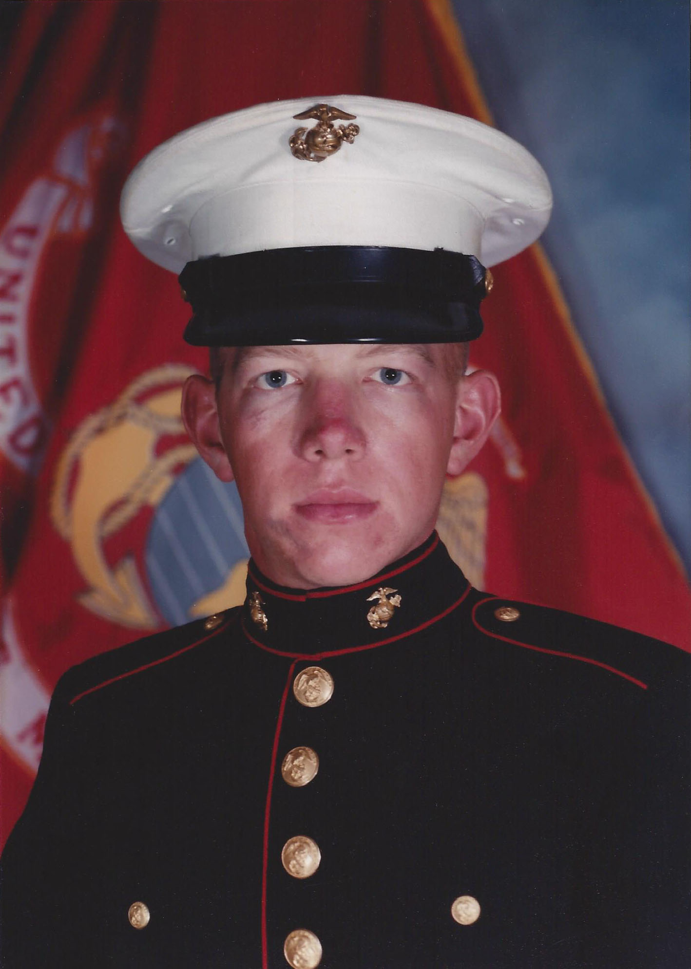
Who is Chad Green?
Director of Architecture at Aline
Previous Positions
Director of Software Development
Data & Solutions Architect
Service Delivery Manager
Product Delivery Manager
Project Manager
.NET Solution Architect
Developer
Community Involvement
Code PaLOUsa Conference Chair
Louisville .NET Meetup Organizer
Louisville Tech Leaders Meetup Organizer
Louisville Tech Ladies Co-Organizer
United States Marine Corps Veteran

Slide 6

Some people spend an entire lifetime wondering if they made a difference. The Marines don’t have that problem
Ronald Reagan

Slide 7
Leadership is more than leading
The power or ability to lead other people
The sum of those qualities of intellect, human understanding, and moral character that enables a person to inspire and control a group of people successfully

Slide 8


Slide 9
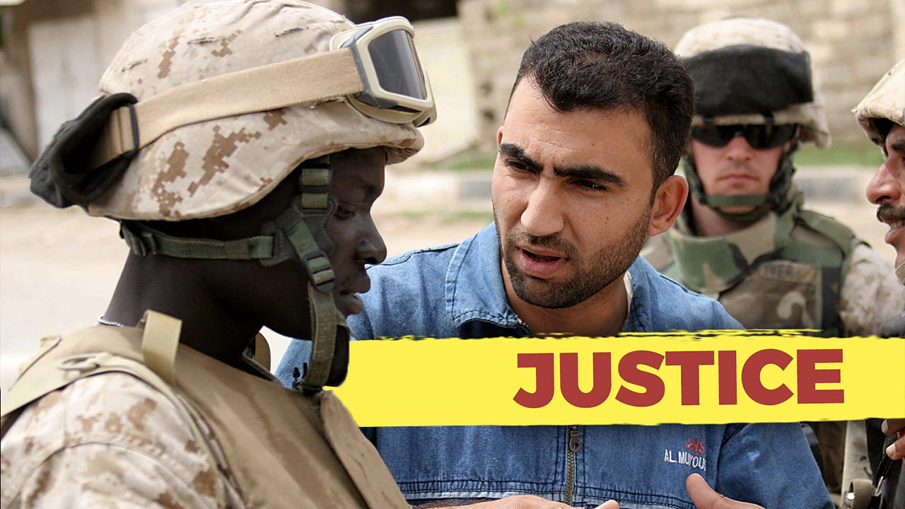
Notes:
Fair and Consistent – Be honest with yourself about decisions. Avoid favoritism. Treat all people, and things equally.
The "Justice" leadership trait from the US Marine Corps leadership principles emphasizes being fair and impartial in decision-making, ensuring that rewards and consequences are distributed equitably. While the context of the Marine Corps and software development teams are quite different, there are valuable lessons from the "Justice" trait that can be applied to leading a software development team effectively:

Slide 10
Fair Allocation of Work
Notes:
Fair Allocation of Work: Just as in the Marines where responsibilities are distributed fairly, a software development leader should ensure that tasks and projects are assigned based on team members' skills and workload capacity. Avoid favoritism or overburdening certain individuals.

Slide 11
Equal Opportunities
Notes:
Equal Opportunities: Uphold fairness by giving all team members the opportunity to contribute to important projects. Avoid excluding or favoring specific individuals based on personal biases, and consider diverse perspectives and ideas.

Slide 12
Merit-Based Recognition
Notes:
Merit-based Recognition: Recognize and reward team members based on their contributions and performance rather than personal preferences. Acknowledge achievements and efforts openly to promote a sense of fairness and motivation among the team.

Slide 13
Transparent Decision-Making
Notes:
Transparent Decision-Making: Communicate the reasoning behind decisions transparently, especially when it comes to resource allocation, project priorities, and performance evaluations. This helps in building trust and understanding among team members.

Slide 14
Accountability and Consequences
Notes:
Accountability and Consequences: Just as in the Marine Corps where accountability is important, hold team members accountable for their actions and performance. Address poor performance or behavior consistently and fairly, applying appropriate consequences as necessary.

Slide 15
Equitable Workload
Notes:
Equitable Workload: Ensure that the workload is distributed evenly among team members to prevent burnout and maintain a healthy work-life balance. Address any concerns or disparities promptly to maintain morale and productivity.

Slide 16
Unbiased Conflict Resolution
Notes:
Unbiased Conflict Resolution: When conflicts arise, handle them impartially and ensure that all parties involved have an opportunity to share their perspective. Strive for solutions that are just and reasonable for all parties.

Slide 17
Ethical Considerations
Notes:
Ethical Considerations: Consider the ethical implications of decisions and actions within the software development process. Uphold ethical standards and avoid any unfair practices that could compromise the quality of the work or the well-being of team members.

Slide 18
Notes:
Remember that while the leadership traits from the Marine Corps are adapted to the context of a software development team, the essence of fairness, integrity, and equity can contribute to creating a positive and effective leadership style in any environment.

Slide 19

Notes:
Good Judgement – Do not make rash decisions. Handle problems with a common sense attitude
The "Judgment" leadership trait from the US Marine Corps focuses on making informed and sound decisions, even in challenging and uncertain situations. Applying this trait to leading a software development team involves making thoughtful and strategic choices to guide the team towards success. Here's how you can apply the "Judgment" trait to lead a software development team effectively:

Slide 20
Gather Information
Notes:
Gather Information: Before making decisions, gather all relevant information about the project, the team's capabilities, the technology landscape, and potential challenges. Understand the context to make informed choices.

Slide 21
Analyze Options
Notes:
Analyze Options: Consider multiple solutions or approaches to a problem. Evaluate the pros and cons of each option, taking into account technical feasibility, resource availability, and potential impact on the project.

Slide 22
Risk Assessment
Notes:
Risk Assessment: Identify potential risks and uncertainties associated with different decisions. Assess the potential consequences and likelihood of each risk and devise strategies to mitigate them.

Slide 23
Involve the Team
Notes:
Involve the Team: Seek input from your team members. They often possess valuable insights and diverse perspectives that can contribute to better decision-making. Encourage open discussions and brainstorming sessions.

Slide 24
Balance Short-Term and Long-Term Goals
Notes:
Balance Short-Term and Long-Term Goals: Consider both immediate project needs and the long-term goals of the software development team. Ensure that decisions align with the overall strategy and vision.

Slide 25
Decisiveness
Notes:
Decisiveness: While thorough analysis is important, timely decision-making is crucial in software development. Avoid getting caught in analysis paralysis and be prepared to make tough decisions when needed

Slide 26
Adaptability
Notes:
Adaptability: The software development landscape is dynamic and can change rapidly. Be prepared to adjust your decisions based on new information, changing requirements, or unexpected developments.

Slide 27
Account for Trade-Offs
Notes:
Account for Trade-offs: Understand that every decision involves trade-offs. Prioritize the most critical factors based on the situation, whether it's functionality, timeline, quality, or resources.

Slide 28
Consider Ethical Implications
Notes:
Consider Ethical Implications: Evaluate decisions from an ethical standpoint. Ensure that your choices align with ethical standards, both in terms of the technology being developed and the treatment of team members.

Slide 29
Communication
Notes:
Communication: Clearly communicate your decisions and the rationale behind them to the team. This transparency fosters trust and helps team members understand the reasoning behind the chosen path.

Slide 30
Learn from Mistakes
Notes:
Learn from Mistakes: Not every decision will lead to success. Embrace failures as learning opportunities. Analyze what went wrong, why it happened, and use these insights to make better decisions in the future.

Slide 31
Continuous Learning
Notes:
Continuous Learning: Stay updated on the latest technologies, industry trends, and best practices in software development. This knowledge equips you to make more informed decisions that align with the evolving landscape.

Slide 32
Notes:
Applying the "Judgment" leadership trait involves a combination of analytical thinking, adaptability, communication, and a willingness to take calculated risks. By honing these skills, you can lead your software development team with confidence and guide them toward successful outcomes.

Slide 33

Notes:
Reliable – Be on time, avoid making excuses, and handle every task to be the best of your ability.
The "Dependability" leadership trait from the US Marine Corps emphasizes reliability, accountability, and consistency. Applying this trait to leading a software development team involves creating a work environment where team members can rely on your leadership, trust your guidance, and feel confident in the team's ability to deliver quality results. Here's how you can apply the "Dependability" trait to lead a software development team effectively:mmon goals.

Slide 34
Lead by Example
Notes:
Lead by Example: Demonstrate the behavior and work ethic you expect from your team. Model professionalism, dedication, and a strong work ethic to set the standard for reliability.

Slide 35
Consistency
Notes:
Consistency: Maintain a consistent leadership approach and decision-making process. Avoid sudden changes in direction that can lead to confusion and frustration among team members.

Slide 36
Reliable Planning
Notes:
Reliable Planning: Develop well-thought-out project plans with realistic timelines and milestones. Consider potential challenges and allocate resources appropriately to ensure the team's success.

Slide 37
Accountability
Notes:
Accountability: Hold yourself and your team members accountable for meeting deadlines and delivering quality work. Address issues promptly and fairly when they arise.

Slide 38
Availability
Notes:
Availability: Be accessible to your team for guidance, support, and problem-solving. Make an effort to address questions and concerns in a timely manner to keep projects on track.

Slide 39
Resource Management
Notes:
Resource Management: Allocate resources efficiently, including both human resources and tools, to ensure that the team has what it needs to accomplish tasks effectively..

Slide 40
Problem Solving
Notes:
Problem Solving: When challenges arise, work collaboratively with your team to identify solutions. Use your experience to guide the team toward effective problem-solving strategies.

Slide 41
Adaptability
Notes:
Adaptability: Be prepared to adapt to changing circumstances and requirements. Your ability to adjust plans while maintaining dependability sends a strong message to your team about your commitment.

Slide 42
Quality Focus
Notes:
Quality Focus: Prioritize delivering high-quality results. Avoid sacrificing quality for speed, and ensure that the team's work meets or exceeds established standards.

Slide 43
Follow Through
Notes:
Follow Through: Ensure that tasks and projects are completed as promised. Avoid making commitments that you cannot fulfill and ensure that your team follows through on their commitments as well.

Slide 44
Build Relationships
Notes:
Build Relationships: Cultivate strong relationships with team members based on trust, respect, and open communication. A dependable leader fosters a positive team atmosphere.

Slide 45
Notes:
By embodying the "Dependability" trait, you can foster a reliable and productive software development team that consistently delivers quality results, meets deadlines, and works cohesively toward common goals.

Slide 46
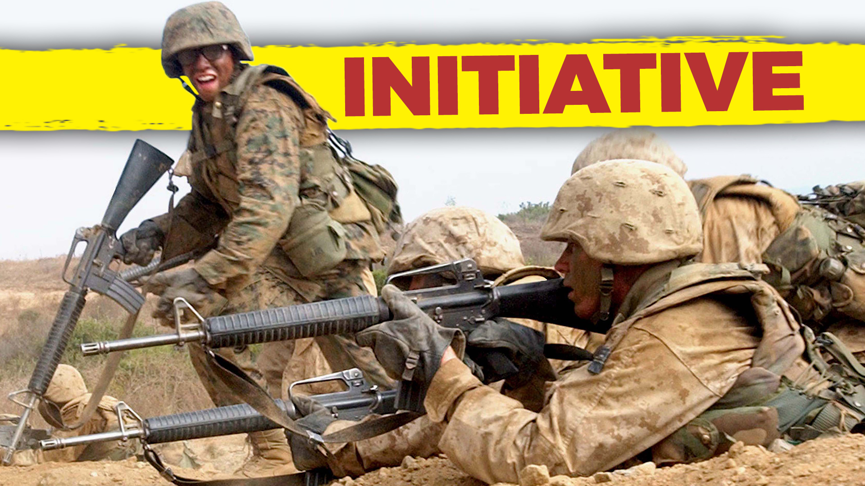
Notes:
Take initiative – Stay alert. Be aware of things that need to be done and then to do them without having to be told.
The "Initiative" leadership trait from the US Marine Corps involves taking action without being told, being proactive, and showing creativity in problem-solving. Applying this trait to leading a software development team entails fostering a culture of innovation, encouraging proactive thinking, and empowering team members to take ownership of their work. Here's how you can apply the "Initiative" trait to lead a software development team effectively:

Slide 47
Encourage Creative Thinking
Notes:
Encourage Creative Thinking: Foster an environment where team members are encouraged to come up with new ideas and solutions. Welcome diverse perspectives and innovative approaches to problem-solving.

Slide 48
Empowerment
Notes:
Empowerment: Delegate responsibilities and decision-making authority to team members. Give them the autonomy to take ownership of their tasks and initiatives, fostering a sense of empowerment.

Slide 49
Lead by Example
Notes:
Lead by Example: Demonstrate initiative in your own actions and decisions. Show your team that you're willing to go above and beyond, inspiring them to do the same.

Slide 50
Identify Opportunities
Notes:
Identify Opportunities: Continuously scan the software development landscape for new opportunities, emerging technologies, and market trends. Encourage your team to explore these opportunities and integrate them into projects.

Slide 51
Risk-Taking
Notes:
Risk-Taking: Embrace calculated risks and encourage your team to do the same. Acknowledge that not every initiative will succeed, but failures can provide valuable learning experiences.

Slide 52
Problem-Solving Culture
Notes:
Problem-Solving Culture: Cultivate a culture where team members actively seek solutions to challenges. Encourage them to address problems proactively rather than waiting for issues to escalate.

Slide 53
Innovation Time
Notes:
Innovation Time: Dedicate time for team members to work on personal projects or explore new ideas. This "innovation time" can lead to creative breakthroughs and novel solutions.

Slide 54
Recognition of Initiative
Notes:
Recognition of Initiative: Acknowledge and celebrate team members who take initiative and contribute innovative ideas. Recognize their efforts to inspire others to follow suit.

Slide 55
Align with Goals
Notes:
Align with Goals: Ensure that initiatives align with the team's goals and the overall business objectives. Initiatives should contribute to the team's mission and strategic direction.

Slide 56
Provide Resource and Support
Notes:
Provide Resources and Support: Offer the necessary resources, tools, and training to support team members' initiatives. Remove obstacles that may hinder their progress.

Slide 57
Learn from Failure
Notes:
Learn from Failure: Emphasize that failure is a part of the learning process. Encourage team members to analyze failures, extract lessons, and apply those lessons to future initiatives

Slide 58
Notes:
By embracing the "Initiative" trait, you can create a dynamic and innovative software development team that proactively seeks solutions, explores new opportunities, and drives continuous improvement. This proactive approach can lead to increased creativity, efficiency, and overall success for your team and projects.

Slide 59

Notes:
Good decisions without delay – Be positive in your actions. Act with conviction and avoid changing directions on an issue.
The "Decisiveness" leadership trait from the US Marine Corps involves making timely and effective decisions, even in high-pressure situations. Applying this trait to leading a software development team involves making well-informed choices that guide the team toward successful outcomes. Here's how you can apply the "Decisiveness" trait to lead a software development team effectively:

Slide 60
Clear Vision
Notes:
Clear Vision: Establish a clear vision for the project and the team's goals. This clarity will provide a foundation for making decisions that align with the larger objectives.

Slide 61
Gather Information
Notes:
Gather Information: Collect relevant information and data before making decisions. Consider the technical aspects, project requirements, constraints, and potential risks

Slide 62
Prioritize
Notes:
Prioritize: Assess the urgency and impact of different decisions. Prioritize tasks and choices based on their significance to the project's success.

Slide 63
Rapid Response
Notes:
Rapid Response: In time-sensitive situations, demonstrate the ability to make quick decisions. Balance speed with thorough consideration to avoid hasty choices.

Slide 64
Analysis-Action Balance
Notes:
Analysis-Action Balance: Find a balance between analysis and action. While thorough analysis is important, avoid getting stuck in endless deliberation.

Slide 65
Consultation
Notes:
Consultation: Seek input from team members and experts when necessary. Collaborative decision-making can lead to more well-rounded and effective choices.

Slide 66
Risk Management
Notes:
Risk Management: Embrace calculated risks and understand that not all decisions will guarantee success. Assess potential risks and develop contingency plans.

Slide 67
Long-Term Impact
Notes:
Long-Term Impact: Consider the long-term implications of your decisions on the project, the team, and the organization. Strive for choices that contribute to sustained success.

Slide 68
Adaptability
Notes:
Adaptability: Be open to adjusting decisions if new information arises or circumstances change. Adaptability is crucial in the dynamic field of software development.

Slide 69
Communication
Notes:
Communication: Communicate decisions clearly and transparently to the team. Explain the rationale behind your choices to foster understanding and buy-in.

Slide 70
Consistency
Notes:
Consistency: Establish a consistent decision-making framework. This builds trust among team members and helps them predict how decisions will be made.

Slide 71
Decisive Confidence
Notes:
Decisive Confidence: Demonstrate confidence in your decisions, even when faced with uncertainty. Your confidence can inspire trust and stability within the team.

Slide 72
Feedback Loop
Notes:
Feedback Loop: Implement a feedback loop to evaluate the outcomes of decisions. Use this information to learn and improve your decision-making process over time.

Slide 73
Notes:
By embodying the "Decisiveness" trait, you'll lead your software development team with clarity and confidence. Making timely and well-considered decisions will guide your team toward achieving project milestones, handling challenges, and contributing to the overall success of the team's endeavors.

Slide 74
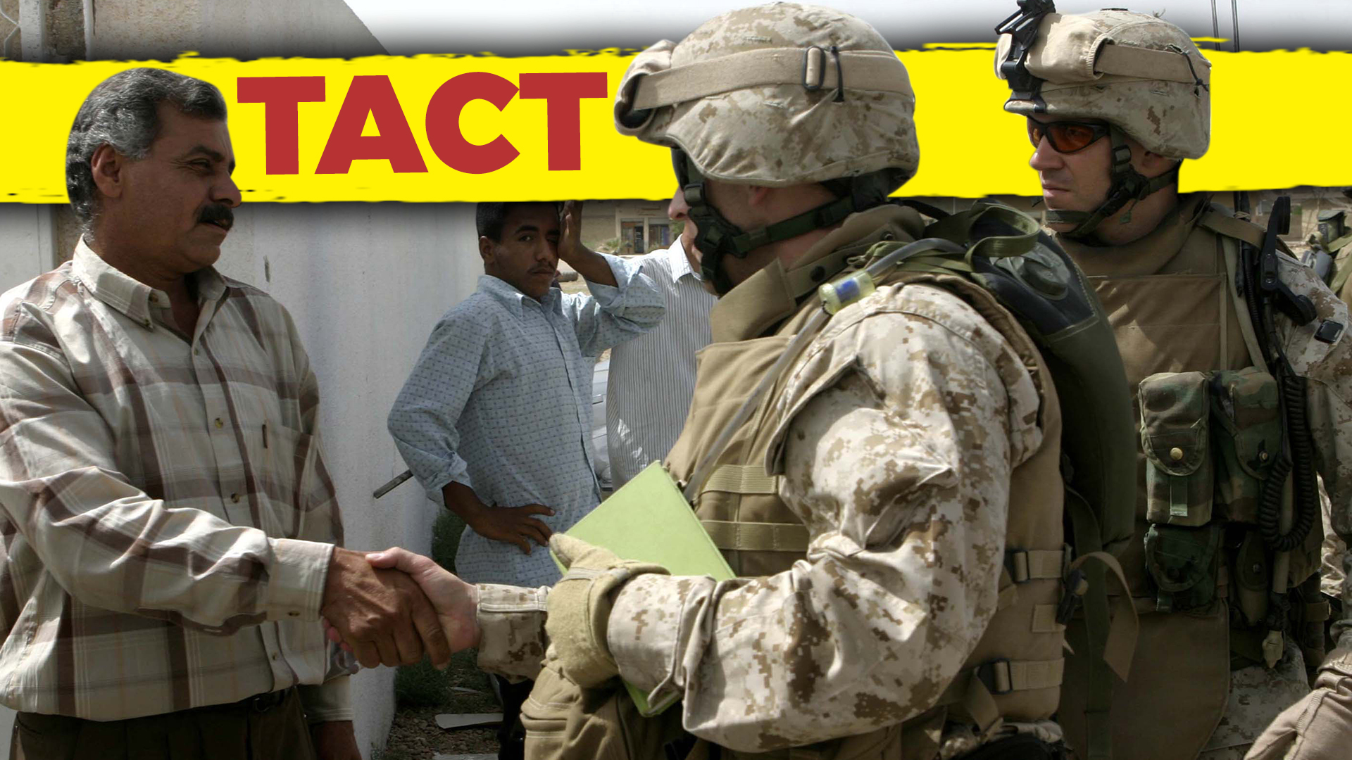
Notes:
Maintain good relations – Be courteous and cheerful at all times. Treat others as you would like to be treated.
The "Tact" leadership trait from the US Marine Corps involves treating others with respect and sensitivity, even in difficult situations. Applying this trait to leading a software development team involves effective communication, fostering a positive work environment, and addressing challenges with empathy and understanding. Here's how you can apply the "Tact" trait to lead a software development team effectively:

Slide 75
Respectful Communication
Notes:
Respectful Communication: Communicate with team members in a respectful and considerate manner. Use positive language and avoid confrontational or aggressive behavior.

Slide 76
Active Listening
Notes:
Active Listening: Practice active listening to understand your team members' concerns, ideas, and feedback. This demonstrates your genuine interest in their perspectives.

Slide 77
Empathy
Notes:
Empathy: Put yourself in your team members' shoes to understand their experiences, challenges, and viewpoints. Show empathy when addressing their needs and concerns.

Slide 78
Constructive Feedback
Notes:
Constructive Feedback: Provide feedback that is both constructive and encouraging. Offer specific examples and suggestions for improvement, while also acknowledging their strengths.

Slide 79
Conflict Resolution
Notes:
Conflict Resolution: Address conflicts and disagreements diplomatically. Encourage open dialogue and find common ground to resolve issues without escalating tensions.

Slide 80
Cultural Sensitivity
Notes:
Cultural Sensitivity: Be mindful of cultural differences and diverse backgrounds within your team. Respect different viewpoints and adapt your communication style accordingly.

Slide 81
Balancing Critique
Notes:
Balancing Critique: When offering critiques or pointing out areas for improvement, do so in a way that focuses on growth and development rather than belittling or demoralizing.

Slide 82
Transparency
Notes:
Transparency: Be open and transparent in your communication, sharing relevant information with your team members. This fosters trust and reduces uncertainty.

Slide 83
Privacy and Confidentiality
Notes:
Privacy and Confidentiality: Respect team members' privacy and maintain confidentiality when handling sensitive matters, such as personal issues or sensitive project information.

Slide 84
Personalized Leadership
Notes:
Personalized Leadership: Understand that each team member has unique needs and preferences. Tailor your leadership approach to accommodate individual differences.

Slide 85
Considerate Decision-Making
Notes:
Considerate Decision-Making: When making decisions, consider the potential impact on team members. Strive for choices that are fair and that take into account their well-being.

Slide 86
Notes:
Applying the "Tact" trait can create a positive and inclusive atmosphere within your software development team. By treating your team members with respect, empathy, and sensitivity, you'll foster strong working relationships, enhance communication, and contribute to a more productive and harmonious work environment.

Slide 87

Notes:
Honest and truthful – Be honest and truthful at all times. Have a backbone, stand up for what you believe is right.
The "Integrity" leadership trait from the US Marine Corps involves honesty, ethical behavior, and maintaining a strong moral compass. Applying this trait to leading a software development team involves building trust, upholding ethical standards, and fostering a culture of transparency and accountability. Here's how you can apply the "Integrity" trait to lead a software development team effectively:

Slide 88
Lead by Example
Notes:
Lead by Example: Demonstrate unwavering integrity in your own actions and decisions. Your behavior sets the tone for the team and establishes expectations for ethical conduct.

Slide 89
Honest Communication
Notes:
Honest Communication: Foster open and honest communication with your team. Encourage team members to share their thoughts, concerns, and feedback without fear of reprisal.

Slide 90
Ethical Decision-Making
Notes:
Ethical Decision-Making: Make decisions based on ethical considerations and the best interests of the team, the organization, and stakeholders. Avoid compromising your principles for short-term gains.

Slide 91
Transparency
Notes:
Transparency: Communicate openly about project status, challenges, and changes. Be transparent about decisions and the reasoning behind them to build trust.

Slide 92
Accountability
Notes:
Accountability: Hold yourself and your team members accountable for their actions and decisions. Admit mistakes and take responsibility when things go wrong.

Slide 93
Consistency
Notes:
Consistency: Maintain consistency in your values and actions. Uphold your principles even when facing difficult decisions or challenging situations.

Slide 94
Respect for Others
Notes:
Respect for Others: Treat team members, stakeholders, and colleagues with respect and dignity. Create an environment where everyone feels valued and included.

Slide 95
Ethical Standards in Technology
Notes:
Ethical Standards in Technology: Ensure that the software being developed aligns with ethical standards, respecting user privacy, security, and societal well-being.

Slide 96
Adherence to Guidelines
Notes:
Adherence to Guidelines: Adhere to industry standards, best practices, and legal regulations in software development. Uphold quality and security standards in all projects

Slide 97
Inclusion and Diversity
Notes:
Inclusion and Diversity: Promote an inclusive and diverse environment that respects and values different perspectives, backgrounds, and experiences.

Slide 98
Integrity in Documentation
Notes:
Integrity in Documentation: Ensure that project documentation accurately represents the work being done and that information is not distorted or misrepresented.

Slide 99
Notes:
By embodying the "Integrity" trait, you can build a software development team that operates with honesty, ethical behavior, and a commitment to doing what is right. This not only enhances the team's reputation but also establishes a strong foundation for collaboration, innovation, and long-term success.

Slide 100

Notes:
Interested and exuberant – You are enthusiastic, optimistic, cheerful, and willing to accept challenges.
The "Enthusiasm" leadership trait from the US Marine Corps involves showing genuine passion, energy, and positive attitude. Applying this trait to leading a software development team involves inspiring motivation, fostering a vibrant work environment, and encouraging creativity. Here's how you can apply the "Enthusiasm" trait to lead a software development team effectively:

Slide 101
Passion for Technology
Notes:
Passion for Technology: Exhibit genuine excitement for technology and software development. Share your enthusiasm for the field to inspire your team's interest and motivation.

Slide 102
Positive Attitude
Notes:
Positive Attitude: Maintain a positive and optimistic outlook, even in the face of challenges. Your attitude can influence the team's morale and overall work atmosphere.

Slide 103
Inspire Creativity
Notes:
Inspire Creativity: Encourage innovative thinking and creative problem-solving. Your enthusiasm for new ideas can stimulate your team to explore novel solutions.

Slide 104
Celebration of Achievements
Notes:
Celebration of Achievements: Celebrate successes, whether they're small milestones or major accomplishments. Recognize and appreciate your team's hard work and contributions.

Slide 105
Motivate and Energize
Notes:
Motivate and Energize: Infuse energy into the team by setting an enthusiastic tone during meetings, discussions, and interactions. Your enthusiasm can be contagious.

Slide 106
Open Communication
Notes:
Open Communication: Maintain open channels of communication with your team. Regularly share updates, insights, and progress reports to keep everyone engaged and informed.

Slide 107
Personal Investment
Notes:
Personal Investment: Show that you're invested in the team's growth and success. Offer your time, guidance, and resources to support their professional development.

Slide 108
Lead by Example
Notes:
Lead by Example: Demonstrate your dedication and commitment to the team's goals through your own actions. Show that you're willing to go the extra mile.

Slide 109
Learning Culture
Notes:
Learning Culture: Foster a culture of continuous learning and improvement. Encourage your team to explore new technologies, trends, and skills to stay motivated and relevant.

Slide 110
Listening to Ideas
Notes:
Listening to Ideas: Be receptive to your team's ideas and suggestions. Show genuine interest in their input and incorporate their perspectives into decision-making.

Slide 111
Energetic Meetings
Notes:
Energetic Meetings: Conduct meetings with energy and enthusiasm. Use these opportunities to inspire discussions, share updates, and boost team morale.

Slide 112
Flexibility and Adaptability
Notes:
Flexibility and Adaptability: Adapt your leadership style to match the team's needs and preferences. Being flexible in your approach can foster a more engaged and motivated team.

Slide 113
Public Recognition
Notes:
Public Recognition: Publicly acknowledge team members' contributions and efforts. Highlight their achievements in team meetings or within the organization.

Slide 114
Maintain Momentum
Notes:
Maintain Momentum: Sustain your enthusiasm throughout the project lifecycle. Consistent enthusiasm can help keep motivation high even during challenging phases

Slide 115
Notes:
By embodying the "Enthusiasm" trait, you can create a software development team that is motivated, inspired, and excited about their work. Your positive attitude and passion can contribute to a vibrant work culture, increased creativity, and a greater sense of camaraderie among team members.

Slide 116
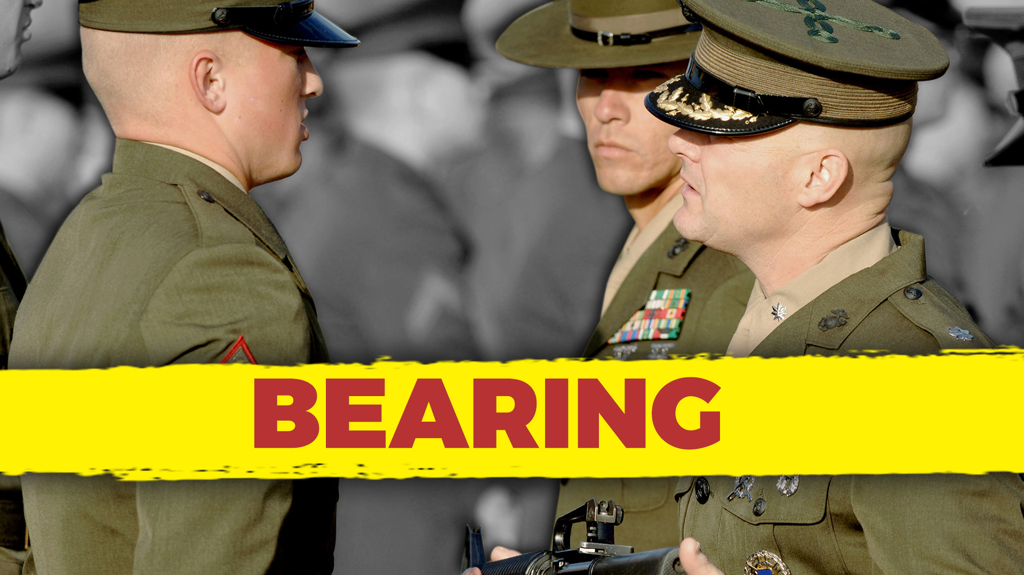
Notes:
Competent, confident, and in-control – Reach for the top standards of conduct. Just getting by is unacceptable.
The "Bearing" leadership trait from the US Marine Corps involves projecting confidence, composure, and a professional demeanor. Applying this trait to leading a software development team involves maintaining a strong and composed presence, demonstrating professionalism, and effectively managing emotions in various situations. Here's how you can apply the "Bearing" trait to lead a software development team effectively:

Slide 117
Confident Presence
Notes:
Confident Presence: Project confidence in your decisions and actions. Your demeanor can inspire trust and create a sense of stability within the team.

Slide 118
Professionalism
Notes:
Professionalism: Set high standards for professionalism in both your behavior and your team's conduct. Uphold a respectful and ethical work environment.

Slide 119
Calm under Pressure
Notes:
Calm under Pressure: Maintain composure, especially during challenging situations or tight deadlines. Your ability to stay calm can positively influence the team's response.

Slide 120
Effective Communication
Notes:
Effective Communication: Communicate clearly and effectively, especially when conveying complex information or addressing sensitive topics. Your communication style sets the tone for the team's interactions.

Slide 121
Decisiveness
Notes:
Decisiveness: Make decisions confidently, even in uncertain circumstances. Your decisiveness can provide clarity and direction for the team.

Slide 122
Poise in Conflict
Notes:
Poise in Conflict: Handle conflicts and disagreements with poise and professionalism. Encourage productive discussions while preventing situations from escalating.

Slide 123
Empathy and Understanding
Notes:
Empathy and Understanding: Show empathy and understanding towards team members' concerns, emotions, and challenges. Your balanced approach can foster a supportive atmosphere.

Slide 124
Modeling Behavior
Notes:
Modeling Behavior: Set an example for the team by demonstrating the behavior, work ethic, and attitude you expect from them. Lead by showing, not just telling.

Slide 125
Grace under Criticism
Notes:
Grace under Criticism: Receive feedback and criticism with grace and an open mind. Your ability to accept constructive input sets a positive tone for feedback exchanges.

Slide 126
Professional Development
Notes:
Professional Development: Invest in your own professional development to enhance your knowledge and skills. This commitment sets an example for continuous growth.

Slide 127
Handling Ambiguity
Notes:
Handling Ambiguity: Deal with ambiguity and uncertainty with a composed and adaptable attitude. Your ability to navigate through uncertain situations can reassure the team.

Slide 128
Notes:
By embodying the "Bearing" trait, you can create a work environment characterized by professionalism, composure, and a sense of security. Your confident and composed leadership style can positively impact the software development team's morale, performance, and overall effectiveness.

Slide 129

Notes:
Considerate – You give credit to those who deserve it and avoid using your authority for personal gain at the expense of others.
The "Unselfishness" leadership trait from the US Marine Corps involves putting the needs of the team and the mission ahead of personal desires. Applying this trait to leading a software development team involves prioritizing the well-being and growth of your team members, fostering collaboration, and focusing on the team's collective success. Here's how you can apply the "Unselfishness" trait to lead a software development team effectively:

Slide 130
Support Team Growth
Notes:
Support Team Growth: Invest in the professional development of your team members. Provide opportunities for learning, training, and skill enhancement to help them grow in their roles.

Slide 131
Empowerment
Notes:
Empowerment: Delegate responsibilities and decision-making to team members, allowing them to take ownership of their work and contribute meaningfully to the team's success.

Slide 132
Share Credit
Notes:
Share Credit: Acknowledge and give credit to your team members for their achievements and contributions. Highlight their individual and collective efforts.

Slide 133
Open Collaboration
Notes:
Open Collaboration: Encourage a culture of open collaboration and knowledge sharing. Foster an environment where team members freely exchange ideas and support one another.

Slide 134
Prioritize Team Needs
Notes:
Prioritize Team Needs: Consider the needs of the team when making decisions. Strive for choices that benefit the team's well-being and long-term growth.

Slide 135
Selfless Service
Notes:
Selfless Service: Lead by example by demonstrating a willingness to take on tasks that benefit the team, even if they fall outside your primary responsibilities.

Slide 136
Team Goals Over Personal Goals
Notes:
Team Goals Over Personal Goals: Prioritize the team's goals and success over personal agendas. Make decisions that align with the collective mission rather than personal gain.

Slide 137
Servant Leadership
Notes:
Servant Leadership: Embrace a servant leadership approach, where your focus is on serving the needs of the team and helping them achieve their objectives.

Slide 138
Embrace Diverse Perspectives
Notes:
Embrace Diverse Perspectives: Encourage team members to share their unique viewpoints and perspectives. Embrace diversity of thought and experience to drive innovation.

Slide 139
Conflict Resolution
Notes:
Conflict Resolution: Handle conflicts and disagreements with the team's best interests in mind. Seek resolutions that promote unity and collaboration.

Slide 140
Promote a Positive Culture
Notes:
Promote a Positive Culture: Foster a positive and inclusive work culture where team members feel valued and supported, enabling them to contribute their best.

Slide 141
Balancing Workload
Notes:
Balancing Workload: Distribute tasks and responsibilities fairly, taking into account each team member's strengths, workload capacity, and growth goals.

Slide 142
Notes:
By embodying the "Unselfishness" trait, you can create a collaborative and supportive environment within your software development team. Putting the team's needs first, prioritizing their growth, and promoting a sense of collective achievement can lead to higher morale, increased engagement, and ultimately, greater success for the entire team.

Slide 143

Notes:
Remain calm while facing fear – Practice self-discipline and calmness. Force yourself to control your reaction to fear.
The "Courage" leadership trait from the US Marine Corps involves facing challenges and making tough decisions even in the face of adversity. Applying this trait to leading a software development team involves demonstrating resilience, taking calculated risks, and standing up for what is right. Here's how you can apply the "Courage" trait to lead a software development team effectively:

Slide 144
Embrace Innovation
Notes:
Embrace Innovation: Encourage your team to explore innovative ideas and technologies. Embrace the uncertainty that comes with trying new approaches to software development.

Slide 145
Risk Management
Notes:
Risk Management: Analyze risks associated with project decisions, but don't shy away from necessary risks that can lead to greater rewards. Make informed decisions that balance potential benefits and drawbacks.

Slide 146
Stand Up for Values
Notes:
Stand Up for Values: Uphold ethical standards and ensure that the software being developed aligns with ethical guidelines. Be willing to challenge decisions that compromise your team's integrity.

Slide 147
Difficult Conversations
Notes:
Difficult Conversations: Address conflicts, performance issues, and sensitive topics with courage and professionalism. Approach difficult conversations in a constructive and empathetic manner.

Slide 148
Adaptability
Notes:
Adaptability: Be open to change and willing to adapt your strategies as circumstances evolve. Display the courage to pivot when necessary to achieve better results.

Slide 149
Champion New Ideas
Notes:
Champion New Ideas: Advocate for your team's ideas and proposals, even if they challenge the status quo. Stand up for initiatives that have the potential to drive positive change.

Slide 150
Accountability
Notes:
Accountability: Take responsibility for both successes and failures. Acknowledge your role in decision-making and outcomes, showing that you're willing to learn from experiences.

Slide 151
Speak Up
Notes:
Speak Up: Be willing to voice your opinions and concerns, even if they go against popular viewpoints. Constructively express your thoughts to contribute to meaningful discussions.

Slide 152
Moral Courage
Notes:
Moral Courage: Stand up for what is right, even when it's difficult or unpopular. Advocate for fairness, diversity, inclusion, and ethical behavior within your team.

Slide 153
Balancing Stakeholder Interests
Notes:
Balancing Stakeholder Interests: Navigate competing interests from stakeholders while making decisions that prioritize the long-term success of the project and the well-being of your team.

Slide 154
Resilience
Notes:
Resilience: Stay strong and composed in the face of setbacks, failures, or challenges. Show your team that setbacks are opportunities for growth and learning.

Slide 155
Inclusive Leadership
Notes:
Inclusive Leadership: Have the courage to actively seek out diverse perspectives and create an inclusive environment that welcomes different voices.

Slide 156
Transparency
Notes:
Transparency: Communicate openly about project challenges, setbacks, and uncertainties. Your willingness to share difficult information fosters trust and transparency.

Slide 157
Supporting Your Team
Notes:
Supporting Your Team: Be an advocate for your team, providing them with the resources and support they need to overcome obstacles and achieve their goals.

Slide 158
Lead with Conviction
Notes:
Lead with Conviction: Lead your team with unwavering conviction in your decisions and strategies. Display confidence that inspires trust and commitment from your team members.

Slide 159
Notes:
By embodying the "Courage" trait, you can create a software development team that is willing to take calculated risks, face challenges head-on, and uphold ethical principles. Your courage will inspire your team to approach their work with determination, resilience, and a commitment to achieving excellence.

Slide 160
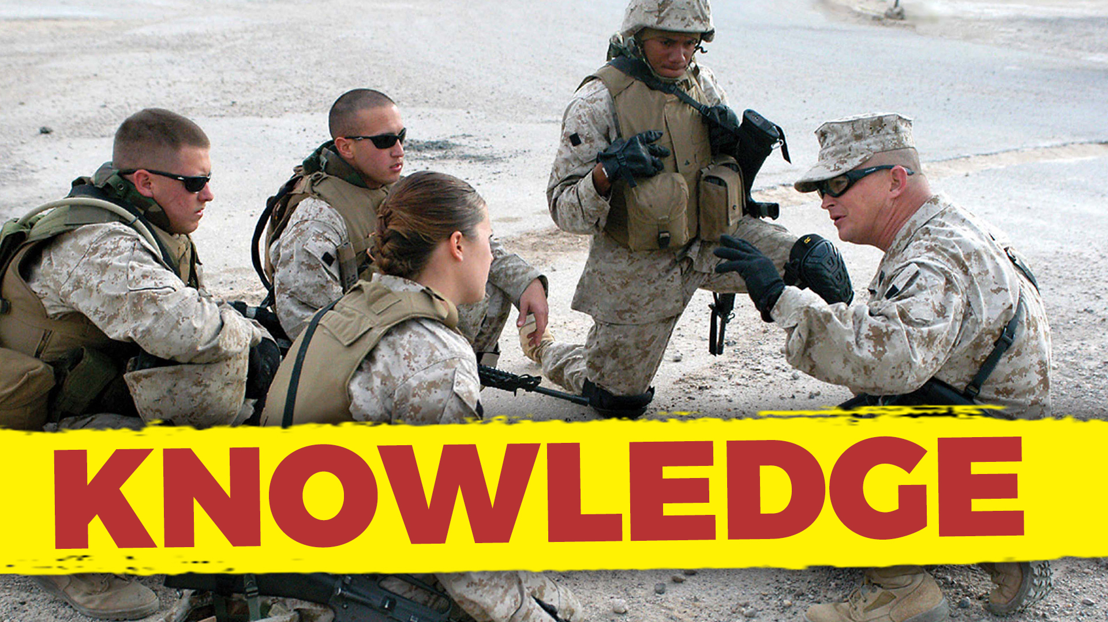
Notes:
Knowledgeable – Remain alert. Listen, observe, and find out about things you don’t get. Study and stay current!
The "Knowledge" leadership trait from the US Marine Corps involves continuously seeking to improve one's expertise and sharing that knowledge with others. Applying this trait to leading a software development team involves staying updated on industry trends, sharing insights, fostering a learning culture, and guiding the team with your expertise. Here's how you can apply the "Knowledge" trait to lead a software development team effectively:

Slide 161
Continuous Learning
Notes:
Continuous Learning: Stay current with the latest trends, technologies, and best practices in software development. Dedicate time to learn and expand your knowledge.

Slide 162
Industry Expertise
Notes:
Industry Expertise: Develop deep knowledge of your field, including programming languages, frameworks, methodologies, and emerging technologies.

Slide 163
Share Insights
Notes:
Share Insights: Share your expertise and insights with your team. Offer guidance, answer questions, and provide valuable input based on your knowledge.

Slide 164
Mentorship
Notes:
Mentorship: Act as a mentor to team members, providing guidance and support in their professional growth. Help them acquire new skills and knowledge.

Slide 165
Learning Opportunities
Notes:
Learning Opportunities: Encourage your team to engage in continuous learning. Provide resources, training, and opportunities for skill development.

Slide 166
Innovation
Notes:
Innovation: Apply your knowledge to drive innovation within the team. Identify opportunities for process improvement and new approaches to software development.

Slide 167
Technical Leadership
Notes:
Technical Leadership: Lead by example with your technical skills. Show your team how to approach coding, testing, and debugging effectively.

Slide 168
Stay Informed
Notes:
Stay Informed: Keep yourself informed about relevant news, updates, and advancements in software development. Share this information with your team to keep them updated.

Slide 169
Adaptation
Notes:
Adaptation: Apply your knowledge to adapt to changing circumstances. Help your team pivot when necessary, using your insights to guide strategic decisions.

Slide 170
Feedback and Coaching
Notes:
Feedback and Coaching: Provide constructive feedback to help team members improve their technical skills. Coach them on best practices and offer suggestions for improvement.

Slide 171
Contribute to Strategy
Notes:
Contribute to Strategy: Use your knowledge to contribute to the team's strategic planning. Your insights can help shape long-term objectives and directions.

Slide 172
Collaboration
Notes:
Collaboration: Collaborate with team members on technical discussions and decisions. Encourage brainstorming and the sharing of ideas to enhance problem-solving.

Slide 173
Promote Learning Culture
Notes:
Promote Learning Culture: Instill a culture of continuous learning within the team. Encourage team members to share their knowledge and insights with each other.

Slide 174
Notes:
By embodying the "Knowledge" trait, you can lead your software development team with expertise, provide valuable guidance, and foster a culture of continuous learning and improvement. Your commitment to staying informed and sharing knowledge will empower your team to achieve technical excellence and innovation.

Slide 175

Notes:
Devoted – Never discuss problems with outsiders. Never talk about seniors unfavorably in front of your subordinates.
The "Loyalty" leadership trait from the US Marine Corps involves unwavering commitment to the team, organization, and its members. Applying this trait to leading a software development team involves building trust, fostering a sense of belonging, and prioritizing the well-being of your team members. Here's how you can apply the "Loyalty" trait to lead a software development team effectively:

Slide 176
Build Trust
Notes:
Build Trust: Establish trust among your team members through consistent actions, transparent communication, and a commitment to their success.

Slide 177
Supportive Environment
Notes:
Supportive Environment: Create an environment where team members feel supported and valued. Show that you have their best interests in mind.

Slide 178
Advocate for the Team
Notes:
Advocate for the Team: Act as an advocate for your team within the organization. Make sure their needs, achievements, and concerns are heard and addressed.

Slide 179
Open Communication
Notes:
Open Communication: Foster open and honest communication. Encourage team members to voice their opinions, concerns, and ideas without fear of retribution.

Slide 180
Collaborative Decision-Making
Notes:
Collaborative Decision-Making: Involve team members in decision-making processes that impact their work. Seek their input and involve them in shaping the team's direction.

Slide 181
Conflict Resolution
Notes:
Conflict Resolution: Address conflicts and disputes with the intention of preserving team unity. Find solutions that maintain relationships and promote collaboration.

Slide 182
Recognition and Acknowledgement
Notes:
Recognition and Acknowledgment: Recognize and acknowledge the contributions of your team members. Publicly appreciate their efforts to reinforce their sense of loyalty.

Slide 183
Consistency
Notes:
Consistency: Demonstrate consistent commitment to the team's goals and well-being. Your reliability builds a foundation of trust and loyalty.

Slide 184
Professional Development
Notes:
Professional Development: Invest in your team's professional development. Support their growth by providing learning opportunities and advancement paths.

Slide 185
Personal Connection
Notes:
Personal Connection: Get to know your team members on a personal level. Understand their strengths, interests, and aspirations, fostering a deeper connection.

Slide 186
Resolve Conflict
Notes:
Resolve Conflicts: Mediate conflicts within the team and resolve issues fairly. Strive for solutions that maintain a positive team dynamic.

Slide 187
Inclusive Culture
Notes:
Inclusive Culture: Promote an inclusive environment where every team member feels welcome and valued, regardless of their background or perspective.

Slide 188
Share Successes and Challenges
Notes:
Share Successes and Challenges: Communicate both successes and challenges with your team. Your transparency builds trust and shows loyalty to their shared journey.

Slide 189
Stand by Your Team
Notes:
Stand by Your Team: Support your team through difficulties and setbacks. Demonstrate your loyalty by standing by them during challenging times.

Slide 190
Notes:
By embodying the "Loyalty" trait, you can lead your software development team with dedication and commitment. Your loyalty to the team's growth, success, and well-being will foster a strong sense of unity, trust, and collaboration.

Slide 191

Notes:
Mental and physical stamina– Engage in physical training and finish every task to the best of your ability.
The "Endurance" leadership trait from the US Marine Corps involves perseverance and resilience in the face of challenges. Applying this trait to leading a software development team involves demonstrating resilience, providing support during tough times, and promoting a culture of persistence and adaptability. Here's how you can apply the "Endurance" trait to lead a software development team effectively:

Slide 192
Resilient Attitude
Notes:
Resilient Attitude: Maintain a positive and resilient attitude, even when facing setbacks or obstacles. Your demeanor can influence the team's response to challenges.

Slide 193
Lead by Example
Notes:
Lead by Example: Demonstrate your own endurance and determination. Show that you're willing to tackle challenges head-on and overcome adversity.

Slide 194
Steadfast Support
Notes:
Steadfast Support: Provide unwavering support to your team during challenging phases of projects. Show that you're there to help them navigate difficulties.

Slide 195
Adaptability
Notes:
Adaptability: Embrace change and guide your team to be adaptable in the face of evolving project requirements and technological shifts.

Slide 196
Celebrate Small Wins
Notes:
Celebrate Small Wins: Acknowledge and celebrate small victories along the way. These milestones can boost morale and maintain a sense of progress.

Slide 197
Effective Communication
Notes:
Effective Communication: Communicate openly about challenges and setbacks. Address concerns and provide guidance to keep the team motivated.

Slide 198
Learning from Failures
Notes:
Learning from Failures: Encourage the team to view failures as opportunities for learning and growth. Help them extract lessons from setbacks.

Slide 199
Resource Management
Notes:
Resource Management: Manage resources efficiently to ensure the team has what it needs to overcome challenges. Allocate time, tools, and support strategically.

Slide 200
Maintain Perspective
Notes:
Maintain Perspective: Help your team maintain a broader perspective during challenging times. Remind them of the project's goals and the positive impact of their work.

Slide 201
Provide Clear Direction
Notes:
Provide Clear Direction: Offer clear guidance on how to navigate challenges. Help the team understand their roles and responsibilities in overcoming obstacles.

Slide 202
Patience and Persistence
Notes:
Patience and Persistence: Emphasize the value of patience and persistence. Encourage the team not to give up easily, even when faced with complex issues.

Slide 203
Team Unity
Notes:
Team Unity: Foster a sense of unity within the team. Emphasize that everyone is working together to overcome challenges and achieve common goals.

Slide 204
Responsible Risk-Taking
Notes:
Responsible Risk-Taking: Encourage calculated risk-taking when appropriate. Help the team evaluate risks and make informed decisions in the face of uncertainty.

Slide 205
Notes:
By embodying the "Endurance" trait, you can lead your software development team through tough times with resilience and determination. Your ability to persevere and guide the team in overcoming challenges will contribute to their growth, success, and overall effectiveness.

Slide 206
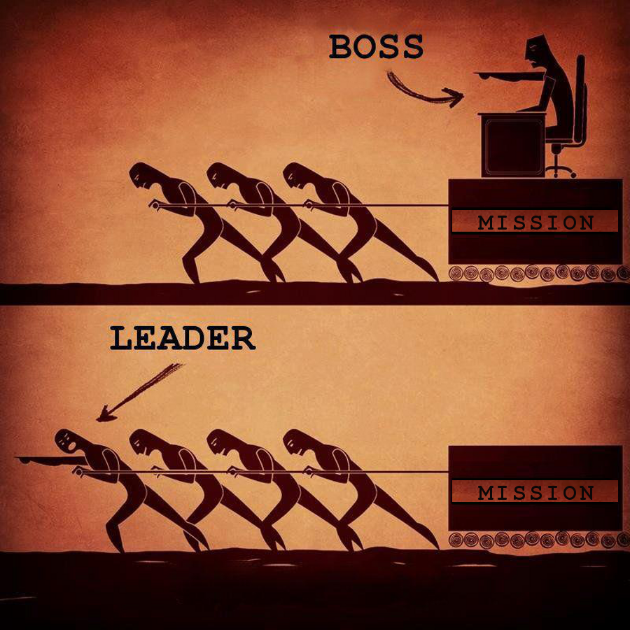

Slide 207
Boss vs Leader
Boss
Leader
Drives employees
Depends on authority
Inspires fear
Says, “I”
Places blame for the breakdown
Knows how it is done
Uses people
Takes credit
Commands
Say, “Go”
Coaches them
On goodwill
Generates enthusiasm
Says, “We”
Fixes the breakdowns
Shows how it is done
Develops people
Gives credit
Asks
Says, “Let’s go”

Slide 208
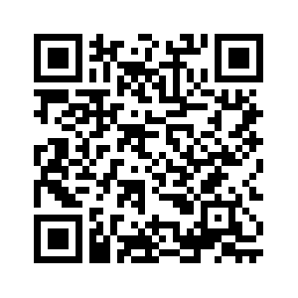
Thank You
chadgreen@chadgreen.com
TaleLearnCode
ChadGreen.com
ChadGreen & TaleLearnCode
ChadwickEGreen

